Slide 1

New Hanover Township
2025 Budget Presentation

Slide 2

What’s a budget?
Notes:
A budget is a spending plan based on revenue and expenses. In other words, it’s an estimate of how much money you’ll make and spend over a period of time. A budget will also help prepare for unexpected expenses and obstacles.

Slide 3
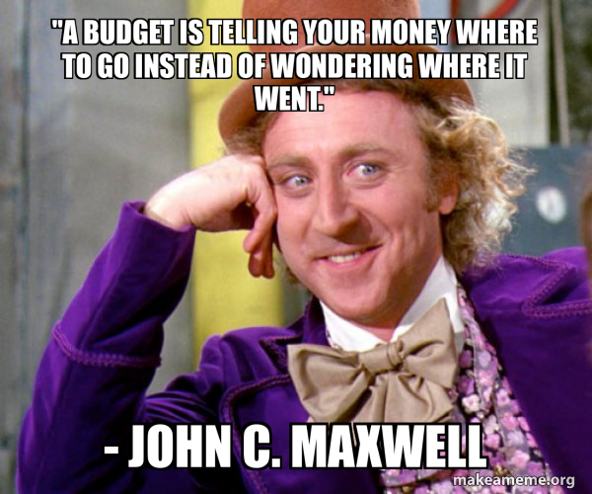

Slide 4

What’s in the budget?
Letter of Transmittal (Budget Message)
Fund Budgets
Supporting Data (Budget Schedules)
These documents are located on our website at
www.newhanover-pa.org.
Notes:
The Letter of Transmittal provides an overview of the budget in a narrative format, offering insights into significant trends, key factors influencing the budget and areas of financial importance. It aims to guide the Board of Supervisors, township staff, and residents through the budgetary process by highlighting programmatic and service-related priorities, cash flow, and revenue-expenditure projections.
The 2025 Budget proposal details 13 distinct funds, each outlining anticipated revenues and planned expenditures for the year in line-item format. The historical data includes a three-year overview of actual (audited) revenues and expenditures, alongside estimated year-end figures for the current year. These figures help identify trends, while beginning and ending fund balances provide an understanding of the Township’s cash position. A summary of the General Fund, highlighting its revenue and expenditure categories, offers a clear view of the Township’s largest operating budget. This is followed by an aggregated summary of all funds, providing a broad financial picture of the Township.
The budget schedules offer additional granularity for individual line items across all operating budgets.

Slide 5
Budget Highlights
The proposed budget maintains current tax rates.
There are two new staff positions in the proposed budget.
The proposed budget maintains municipal services at current levels.
Capital appropriations maintain infrastructure and equipment.

Slide 6
REAL ESTATE ASSESSMENT & TAX LEVY SUMMARY
2006 to 2025
Year | Assessment | Township | School | County | TOTAL
2006 | 542,242,259 | 1.680 | 18.630 | 2.890 | 23.200
2007 | 558,134,099 | 1.680 | 19.420 | 2.840 | 23.940
2008 | 573,092,899 | 1.680 | 20.030 | 2.695 | 24.405
2009 | 594,350,849 | 1.680 | 19.660 | 2.695 | 24.035
2010 | 609,002,899 | 1.680 | 20.360 | 2.695 | 24.735
2011 | 627,427,459 | 1.680 | 21.500 | 2.695 | 25.875
2012 | 641,466,680 | 1.680 | 22.490 | 3.152 | 27.322
2013 | 655,576,000 | 1.680 | 22.970 | 3.152 | 27.802
2014 | 667,524,270 | 1.680 | 23.270 | 3.152 | 28.102
2015 | 683,039,820 | 1.680 | 23.860 | 3.152 | 28.692
2016 | 700,772,300 | 1.680 | 23.860 | 3.459 | 28.999
2017 | 712,603,640 | 1.680 | 24.270 | 3.849 | 29.799
2018 | 720,809,860 | 1.680 | 25.020 | 3.849 | 30.549
2019 | 735,355,240 | 1.587 | 26.370 | 3.849 | 31.806
2020 | 748,512,420 | 1.587 | 27.330 | 3.849 | 32.766
2021 | 766,142,700 | 1.587 | 28.200 | 4.022 | 33.809
2022 | 786,921,832 | 1.587 | 29.046 | 4.022 | 34.655
2023 | 791,461,442 | 1.587 | 30.814 | 4.313 | 36.714
2024 | 797,907,152 | 1.587 | 31.738 | 5.178 | 38.503
2025 | 801,896,688 | 1.587 | 31.738 | 5.178 | 38.503
The proposed budget maintains current tax rates.
Notes:
We have 4 tax levy’s – General Fund (0.957), Fire Protection Fund (0.310), Road Equipment Capital Fund (0.180) and Recreation Fund (0.140). This will be the 19th year in a row that taxes have not been increased; we reduced them by 5% in 2019.

Slide 7

Township 5%
County 12%
School District 83%
LOCAL TAX MILLAGE COMPARISON
Notes:
USE PEN -- Township @ 5% -- County at 12% and School District at 83% -- At the current tax levy of 1.587 mills, real estate taxes for a home assessed at the average assessment value of $154,221 would pay $244 per year or about $20 per month for Township services.

Slide 8
Department | Current | Replacement | Proposed New
Executive | 1 | 0 | 0
Finance Department | 1 | 0 | 0
General Administration | 2 | 0 | 0
Police Department* | 13.5 | 0 | 1
Code Enforcement and Zoning | 2 | 0 | 0
Public Works Department | 7.5 | 0 | 0
Recreation Department | 0 | 0 | 1
Municipal Authority (Sewer) | 4 | 0 | 0
*Part-Time Officer will become Full-Time in 2025 | 31 | 0 | 2
There are 2 new staff positions in the proposed budget.
Notes:
At full staffing levels, we have 33 employees: 31 FTE and 1 PTE. In 2025 we will have 33 FTE, 1 PTE (Public Works Laborer) and 9 lifeguards as seasonal employees.

Slide 9
Budget Overview

Slide 10
Notes:
USE PEN - There are 13 Funds in the proposed budget (1 Governmental Fund, 5 Special Revenue Funds, 3 Capital Project Funds, 2 Enterprise Funds, and 2 Trust Funds). The Government Finance Officers Association (GFOA) recommends a municipality to have between 8% and 12% in fund balance reserves. At the end of 2025, the General Fund will have approximately 18% in fund balance reserves.

Slide 11
Notes:
The General Fund is the largest Operating Fund, supporting core local government services, including police protection; planning and zoning; general administration; finances; legal and engineering services; tax collection services; and public works maintenance.
General Fund appropriations total $5.8 million. Appropriations in the Special Revenue Funds include the Fire Protection Fund ($341,500), Open Space Fund ($461,500), Transportation Impact Fund ($100,000), Recreation Fund ($307,500) and Liquid Fuels Fund ($702,500). Appropriations for the Sewer Operating Fund total $2.52 million and $716,000 for the Sewer Capital Fund. Combined capital appropriations total $642,500 million and pension funds total $603,500.

Slide 12
Notes:
The General Fund, Sewer Operating Fund, and Recreation Fund together account for all personnel, fringe benefit, insurance, routine maintenance and operational expenditures. Personnel costs remain the largest single expense in the operating budgets representing 44% of total appropriations. Operating expenses, contracted services, professional services, and insurance account for an additional 26% to the budget. As is typical in local government, personnel and service costs represent the largest portions of expenditures, meaning significant cost reductions could only be achieved through staffing cuts that would directly impact service delivery.

Slide 13
Budget Highlights
Notes:
Revenue then expenses for GF

Slide 14
Notes:
The main revenue sources for the General Fund include real estate taxes, Act 511 taxes (earned income, per capita, local services, and transfer taxes), business licenses, permit fees, grants, state-shared entitlements, and charges for service. Let’s see some examples.

Slide 15
Notes:
The Township levies a 1% earned income tax and revenue generated from residents is shared equally with the Boyertown School District. Earned income taxes are expected to generate approximately $3.25 million in 2025, accounting for around 63% of the General Fund’s total revenue. Real estate taxes are projected to contribute about $750,000, representing about 15% of total revenue in the General Fund.

Slide 16
Notes:
Transfer taxes are a tax on real estate sales within the Township. The taxes are levied at 2% on property sales within the township, with 1% allocated to the County and the remaining 1% shared equally between the township and the Boyertown School District. The real estate market remains strong, with transfer taxes receipts for 2025 projected to reach approximately $336,000, consistent with 2024 figures.
Approximately 225 properties are expected to change ownership in 2025, which represents an increase from the 2024 budget estimates but aligns with the actual data for the year. Transfer activity in 2024 is projected to account for 4.5% of the Township’s total property base, with about 235 out of 5,171 properties transferring ownership.

Slide 17
Notes:
Permit Fee revenue in 2025 is projected to remain modest, with most approved developments already completed. Revenue is expected to total $120,000, including approximately $28,000 (23% of the total) from an estimated 10 new home permits. This marks a significant drop from the 60 to 100 new home permits issued annually between 2016 and 2021, as new development proposals are still pending approval.

Slide 19
Notes:
Proposed General Fund appropriations for 2025 total $5.8 million, prior to interfund transfers, reflecting a significant $516,000 increase over the 2024 Budget. The majority of this increase is driven by the addition of a full-time police officer and expected contractual wage increases and pension costs ($110,000), contributing to approximately $433,000, or 84% of the increase. Other consistent cost drivers include debt payments through 2032 ($300,000) and the second year of payments for emergency services ($100,000).

Slide 20
Notes:
Routine annual increases are also built into certain budget line items, specifically for wages and benefits. Uniformed employees will receive a contractual wage increase (to be determined), while non-uniformed employees will receive an average 3% increase, with adjustments based on individual performance. Healthcare costs are set to increase by 6.9%, but program rewards have helped reduce the net impact to about 2.95% for 2025.

Slide 21
General Fund
Key Revenues
Key Expenditures
$749,500 in Real Estate Taxes
$3,638,000 in Local Tax Enabling Act Taxes
$198,500 in Licenses and Permits
$261,000 in State Shared Revenue
Personnel
$200,000 in Legal Services
Debt Obligations
$100,000 Annual Contributions
2025 Estimated Net Fund Balance - $1,051,574
Notes:
Government Finance Officers Association (GFOA) recommends a municipality to have between 8% and 12% in fund balance reserves. At the end of 2025, the General Fund will have approximately 18% in fund balance reserves.

Slide 22
Fire Protection Fund
Key Revenues
Key Expenditures
$242,500 in Real Estate Taxes
$95,000 in Foreign Fire Insurance Tax
$215,000 VFC Contribution
$95,000 in Foreign Fire Insurance Tax
2025 Estimated Net Fund Balance - $12,148
Notes:
The Township levies a .310-mill real estate tax dedicated to fire protection services that will generate approximately $245,500 in 2025. The maximum allowable tax levy is three mills. The Fire Company also receives annual state-shared revenue from foreign fire insurers, which is used for relief or pension funds for fire department personnel. At least 30% of the Fire Company’s total revenue is allocated to a capital improvement fund for apparatus purchases.
New Hanover Volunteer Fire & Rescue, an all-volunteer organization, operates from two fire stations strategically located to optimize respond times for providing their services. The North Station which was built in 2019 after being relocated from the Sassamansville Fire Social Club building, has received official ISO (Insurance Service Organization) recognition recently that has improved New Hanover Township’s overall ISO grading to a four.
The fire company has 39 active members who continue to train in their disciplines of service that are provided to our community. 75% of the personnel achieved the nationally recognized Firefighter 1 Pro Board certification and over 30% earned Firefighter 2 certification, totaling over 200 hours of formal fire training. The members also undergo federally mandated Hazardous Materials Operations training. The Department also has 18 administrative support members and offers a Cadet/Junior firefighting program with those community youth interested in preparing for full volunteer firefighter status at age 18.

Slide 23
Open Space Fund
Key Revenues
Key Expenditures
$952,500 in Earned Income Tax
Improvements at Hickory Park
Wassmer Tract Trail Project
Farmland, Passive Meadow, & Trail at 342 Moyer Road
2025 Estimated Net Fund Balance - $3,425,318
Notes:
The Township levies a .15% earned income tax that will generate approximately $1,040,000 in 2025. The tax was initially established in 2006 through resolution to support the conservation of open space and manage growth and development. The tax was later solidified via referendum to finance the purchase of open space and development rights.
The Township currently has 1,599 acres of permanently preserved open space, 2,038 acres of agricultural security area land (which defers taxes for undeveloped agricultural land), and conservation easements on 82.10 acres.

Slide 25
Sewer Operating Fund
Key Revenues
Key Expenditures
$2.12 million in EDU Rental Billings
Personnel
$214,500 in Utilities
Debt Obligations
$250,000 Interfund Transfer to Sewer Capital Fund
2025 Estimated Net Fund Balance - $816,112
Notes:
The Sewer Operating Fund functions as an enterprise fund under a lease agreement between the Township and the New Hanover Township Authority. While the Authority Board sets the sewer rates, the Board of Supervisors approves the budget, and the Township Manager oversees the Authority’s employees.

Slide 26
Notes:
The 2020 loan ends in 2030. There is a prepayment penalty on the loan through 2025.

Slide 27
Sewer Capital Fund
To begin a four-year painting project throughout all owned buildings=$50,000
Sand blasting and painting of a clarifier=$100,000
Variables frequency drives at the Authority building & Swamp Creek Pump Station=$26,000
Digestor Blower Motors design, bidding, and estimated construction cost=$450,000
Replacement Tractor=$90,000
2025 Estimated Net Fund Balance - $280,839
Notes:
AROUND $716,00 IN EXPENSES

Slide 28

Transportation Impact Fund
Seed money specific to traffic design services, permitting, and grant writing services for a traffic signal or roundabout at the intersection of Big Road and Layfield Road.
2025 Estimated Net Fund Balance - $1,875,870

Slide 29

Road Equipment Capital Fund
Purchase of a replacement Pick Up Truck=$75,000
2025 Estimated Net Fund Balance - $707,290
Notes:
$77,500 IN TOTAL EXPENSES ($75K for the truck & $2500 for Tax Collector Commission)

Slide 30
Recreation Operating Fund
Key Revenues
Key Expenditures
$141,000 in Real Estate Taxes
$66,500 in Charges for Services
Personnel
$54,500 in Maintenance
$129,500 in Recreation Activities
$25,000 Interfund Transfer to Recreation Capital Reserve Fund
2025 Estimated Net Fund Balance - $314,512
Notes:
The Recreation Fund supports the operation of recreational programs, managing 302 acres of parks and related services. It is funded through a dedicated tax levy of .180 mills, which will generate $139,000 in 2025. The budget includes park maintenance and program services like summer camps and pool operations. The fund expects $217,500 in revenue and $282,500 in appropriations for 2025, including a $25K transfer to the Recreation Capital Reserve Fund.

Slide 31

Capital Reserve Fund
Replace/rehabilitate the culvert on Deep Creek Rd between Erb Rd. and Schenkler Rd.=$75,000
Milling and Overlay of Buchert Rd. from Romig Rd. to North Charlotte St.=$265,000
Architecture & Engineering Design Fees for renovation the Public Works Building=$75,000
Continued funding for the Swamp Creek Park Meadows Project=$25,000
Seed money for a conceptual Basin Retrofit Program
2 Replacement Vehicles for the Police Department=$180,000
2025 Estimated Net Fund Balance - $549,625
Notes:
$620,000 ANTICIPATED EXPENSES

Slide 32
Recreation Capital Reserve Fund
Plumbing Upgrades to Hickory Park Bathroom=$5,000
Installation of tables with umbrellas and a new pool slide at Hickory Park Pool=$15,000
2025 Estimated Net Fund Balance - $288,438
Notes:
$20K IN TOTAL EXPENSES

Slide 33
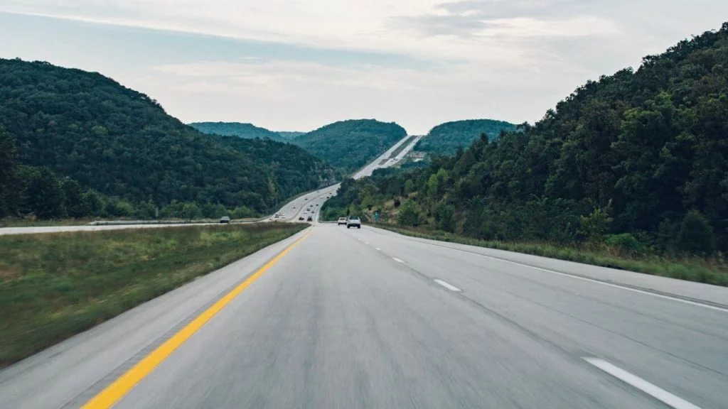
Liquid Fuels Fund
The Township will resurface 7.7 miles of Township roads.
2025 Estimated Net Fund Balance
$328,087
This Photo by Unknown Author is licensed under CC BY-NC-ND
Notes:
State Shared Revenue = $508,500
We will need to consider cutting projects if estimated bids do not come in lower than budgeted.

Slide 34
Notes:
The township is responsible for maintain at least 80 miles of roads, and typically, roads should last about 20 years. To keep up , the township aims to maintain at least four miles of road annually. The 2025 Road Maintenance Program will resurface 7.7 miles, with details in Schedule K. Buchert Rd, from Romig Rd to N. Charlotte, will also be completed using the Capital Reserve Fund.

Slide 35
Future Trends and Outlook
This will be the 19th year in a row that taxes will not be raised (while reducing them in 2019).
GFOA (Government Finance Officers Association) recommends that general-purpose governments maintain an unrestricted budgetary fund balance in their general fund of no less than two months’ worth of revenue and expenditures (16.6%).By the end of 2025, our General Fund will have approximately 18% in reserves.
The Township will see some important revenue sources begin to level off in 2025 as current development is completed, but decisions on new development could shift this outlook.
The Township maintains a good position to plan future budgets strategically and adjust appropriations to match available resources.
Notes:
Government Finance Officers Association

